Slide 1
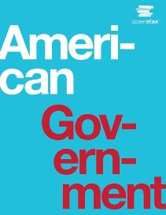
AMERICAN GOVERNMENT
Chapter 3 AMERICAN FEDERALISM
PowerPoint Image Slideshow

Slide 2
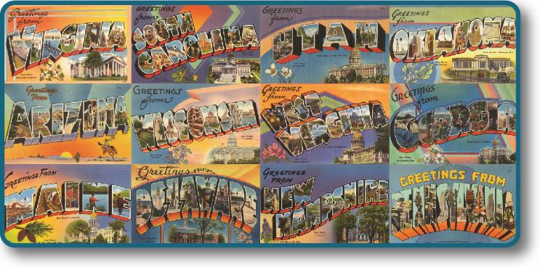
Figure 3.1
Your first encounter with differences across states may have come from a childhood experience—perhaps visiting relatives in another state or going on a cross-country trip with your parents during summer vacation. The distinct postcard images of different states that come to your mind are symbolic of American federalism. (credit: modification of work by Boston Public Library)

Slide 3
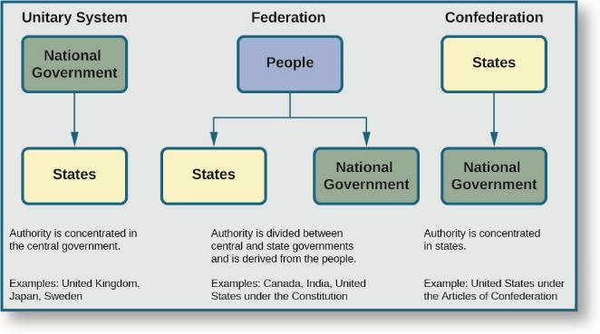
Figure 3.2
There are three general systems of government—unitary systems, federations, and confederations—each of which allocates power differently.

Slide 4
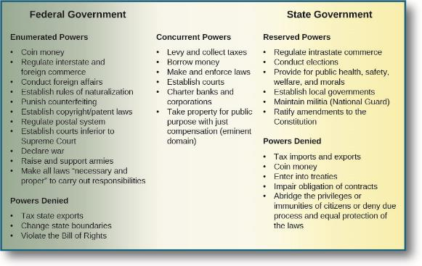
Figure 3.3
Constitutional powers and responsibilities are divided between the U.S. federal and state governments. The two levels of government also share concurrent powers.

Slide 5
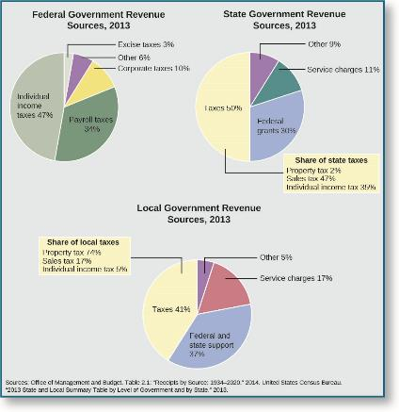
Figure 3.4
As these charts indicate, federal, state, and local governments raise revenue from different sources.

Slide 6
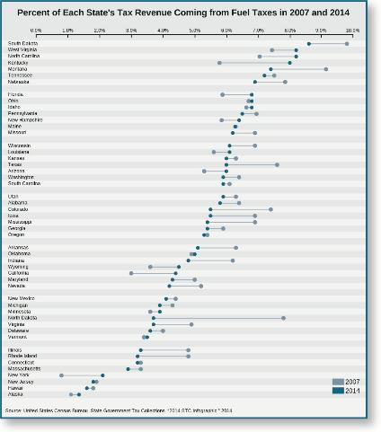
Figure 3.5
The fuel tax as a percentage of tax revenue varies greatly across states.

Slide 7
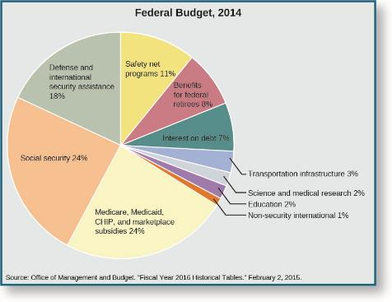
Figure 3.6
Approximately two-thirds of the federal budget is spent in just three categories: Social Security, health care and health insurance programs, and defense.

Slide 8
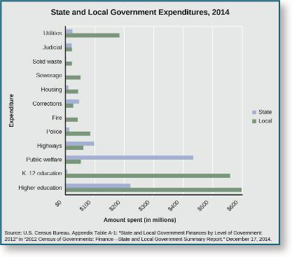
Figure 3.7
This list includes some of the largest expenditure items for state and local governments.

Slide 9
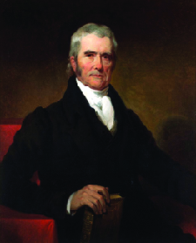
Figure 3.8
Chief Justice John Marshall, shown here in a portrait by Henry Inman, was best known for the principle of judicial review established in Marbury v. Madison (1803), which reinforced the influence and independence of the judiciary branch of the U.S. government.

Slide 10
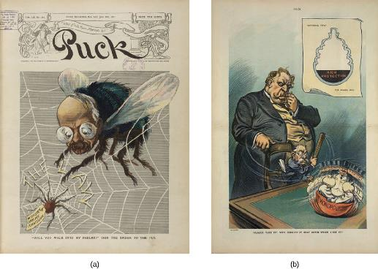
Figure 3.9
Puck, a humor magazine published from 1871 to 1918, satirized political issues of the day such as federal attempts to regulate commerce and prevent monopolies. “‘Will you walk into my parlor?’ said the spider to the fly” (a) by Udo Keppler depicts a spider labeled “Interstate Commerce Commission” capturing a large fly in a web labeled “The Law” while “Plague take it! Why doesn’t it stay down when I hit it?” (b), also drawn by Keppler, shows President William Howard Taft and his attorney general, George W. Wickersham, trying to beat a “Monopoly” into submission with a stick labeled “Sherman Law.”

Slide 11
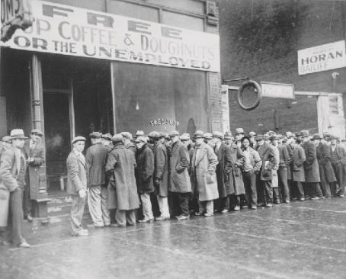
Figure 3.10
A line outside a Chicago soup kitchen in 1931, in the midst of the Great Depression. The sign above reads “Free Soup, Coffee, and Doughnuts for the Unemployed.”

Slide 12
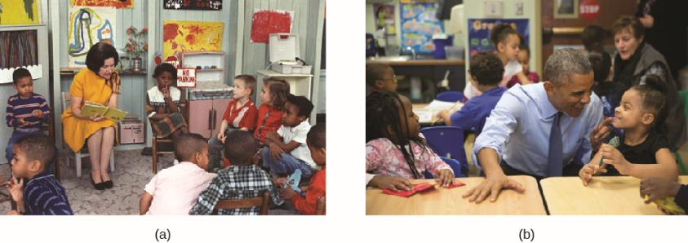
Figure 3.11
Lady Bird Johnson, the First Lady, reads to students enrolled in Head Start (a) at the Kemper School in Washington, DC, on March 19, 1966. President Obama visits a Head Start classroom (b) in Lawrence, Kansas, on January 22, 2015.

Slide 13
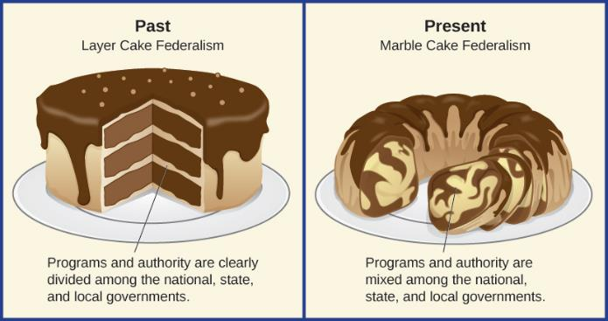
Figure 3.12
Morton Grodzins, a professor of political science at the University of Chicago, coined the expression “marble-cake federalism” in the 1950s to explain the evolution of federalism in the United States.

Slide 14
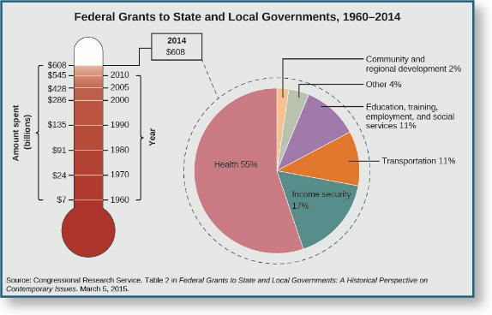
Figure 3.13
As the thermometer shows, federal grants to state and local governments have steadily increased since the 1960s. The pie chart shows how federal grants are allocated among different functional categories today.

Slide 15
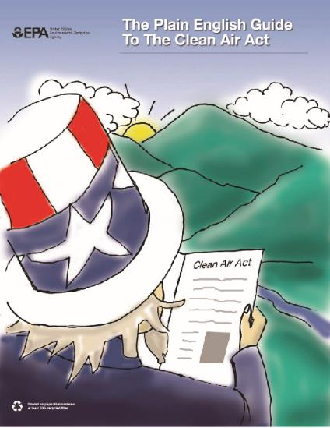
Figure 3.14
The Clean Air Act is an example of an unfunded mandate. The Environmental Protection Agency sets federal standards regarding air and water quality, but it is up to each state to implement plans to achieve these standards.

Slide 16
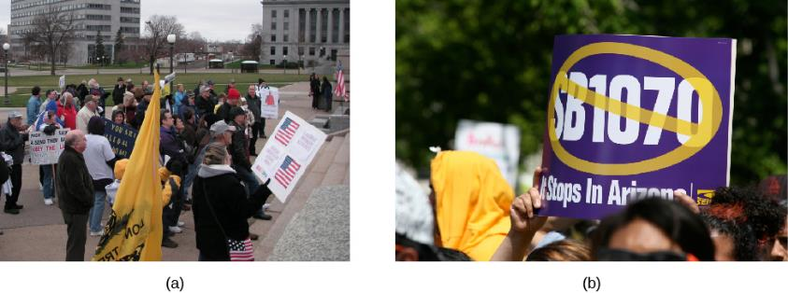
Figure 3.15
Tea Party members in St. Paul, Minnesota, protest amnesty and illegal immigration on November 14, 2009 (a). Following the adoption of Senate Bill 1070 in Arizona, which took a tough stance on illegal immigration, supporters of immigration reform demonstrated across the country in opposition to the bill, including in Lafayette Park (b), located across the street from the White House in Washington, DC. (credit a: modification of work by “Fibonacci Blue”/Flickr; credit b: modification of work by Nevele Otseog)

Slide 17
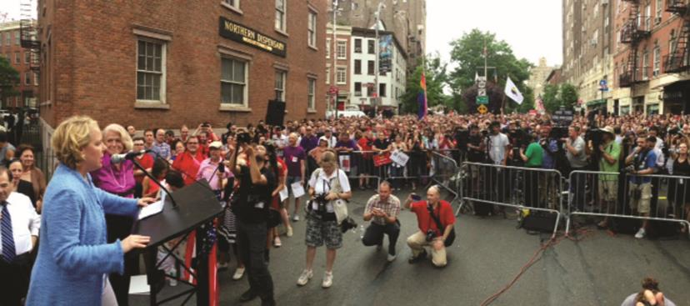
Figure 3.16
With her client Edith Windsor looking on, attorney Roberta Kaplan speaks to the crowd at the site of the 1969 Stonewall Riots, a historic landmark in the movement for LGBT rights. (credit: “Boss Tweed” /Flickr)

Slide 18
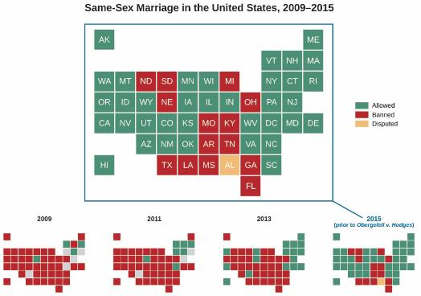
Figure 3.17
The number of states that practiced marriage equality gradually increased between 2008 and 2015, with the fastest increase occurring between United States v. Windsor in 2013 and Obergefell v. Hodges in 2015.

Slide 19
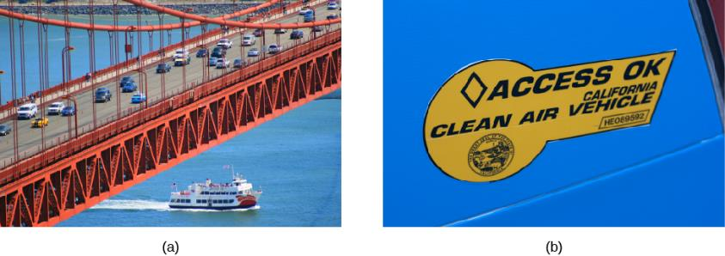
Figure 3.18
The California Air Resources Board was established in 1967, before passage of the federal Clean Air Act. The federal Environmental Protection Agency has adopted California emissions standards nationally, starting with the 2016 model year, and is working with California regulators to establish stricter national emissions standards going forward.(credit a: modification of work by Antti T. Nissinen; credit b: modification of work by Marcin Wichary)

